Slide 1
A.S Watson
Secure 5 Kick Off Project

Slide 2
Agenda
Methodology
Project Scope
Client Deliverables
Project Plan
Implementation Process Overview
UAT Sign Off Document
Project Delivery UAT
Enhancement Hours
Secure 5.2 Workflow and Features
Default User Groups
Available Data Areas
Hierarchy and Alignment
How do Data Policies work?
Business Calendar
Reporting Requirements
Reporting Distribution
LP Case Management
LP Case Management : Approver Flow
Appriss Retail University
Secure Technical Discussion

Slide 3
Project Team
Client Services – Kelly Regan and Liz Webster
Delivery Team – Marek Zielinski
Data Team – Adam Zolnowski
Programme Manager – Jessica Lynch

Slide 4
Methodology
The way this project is going to run and how we escalate

Slide 5
Project Scope
Please See Order Form

Slide 6
Client Deliverables
2 weeks worth of data must be supplied before the project will officially kick off
What other Client Deliverables are there?
What are the dependencies on the Client Deliverables?

Slide 7
Secure 5 Project Plan
Demo

Slide 8
Implementation Process Overview

Slide 9
UAT Sign Off Document
Demo

Slide 10
Project Delivery UAT
Tickets will be raised in Appriss Retail JIRA
Ticket Priority in JIRA:
Contract | JIRA | Definition and Examples
High | Blocker | The platform is completely unusable e.g. Platform will not install; I cannot log in
 | Critical | Critical: There is a bug that is preventing me from reaching my goal e.g. I am unable to run a search; I cannot submit a Case form
Medium | Major | There is a bug that affects my workflow, but I am still able to continue within it e.g. A search is returning unexpected results; I am able to view something I don’t have permission to
Low | Minor | There is a bug that is visible to me, but it has no impact on my workflow e.g. A lightbox is displaying too large; the search progress feedback is misaligned in a specific browser
 | Trivial | There is a minor UI issue e.g. There is a grammatical error; there is a spelling mistake

Slide 11
Enhancement Hours
How do we track hours?
How do we manage change requests?
SOWs

Slide 12
Secure 5
Workflow and Features

Slide 13
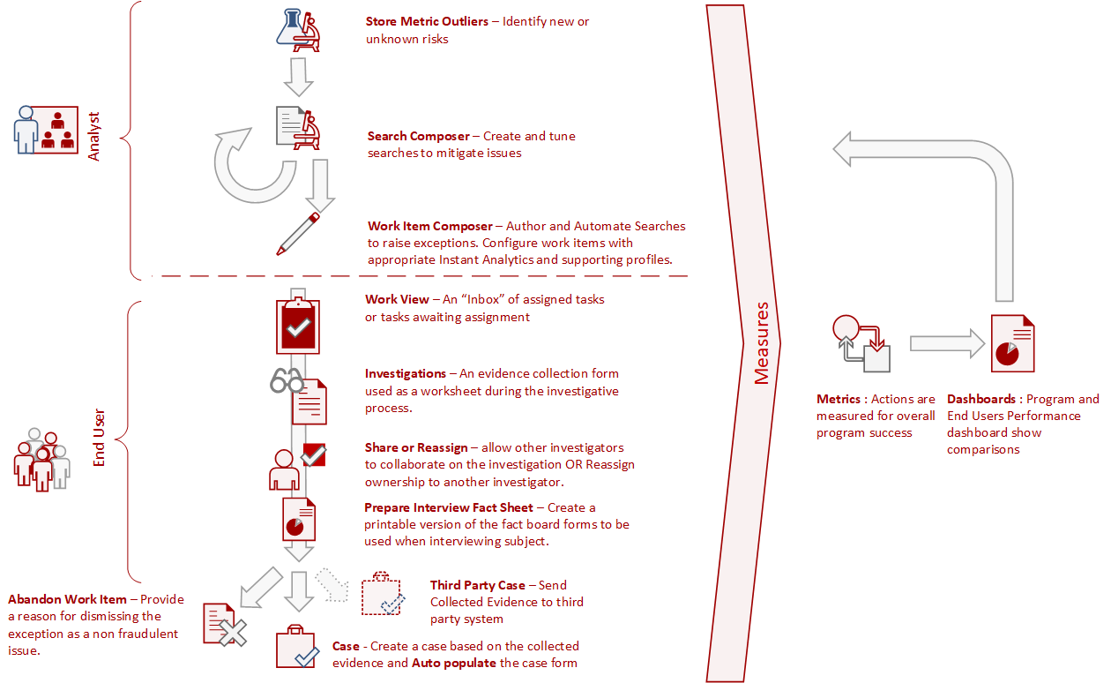
Secure 5.2 Workflow

Slide 14
Secure 5.2 Workflow
Step 1
Step 2
Step 3
Manual
Manual
Investigations App
Prescriptive Investigation Templates
Auto populate from Investigation
Approved
Work View
CRUD
Send
Share
Activity Log
Case Management
Approval and Rejection
Automated work view items from Instant Analytics
Attach
Notes
Move Assets Between
Rejection reason and notifications
Abandon
Abandon an Investigation will offer Abandon All Work Items in this Investigation or move them back to Work Item

Slide 15
Default User Groups
AS Watson Users in Contract | Contract Classification | User Group | Definition
5 | Analyst | Client Administrator | Have access to Administration functionality that you would not like to expose to other users. This includes User Management and Location Hierarchy. The Superuser or Administrator of Secure for the Client.
 | Analyst | Analyst | Have the ability to search and manipulate all available data within the system on an ad hoc basis or on a scheduled basis. The Analyst User has full access to all features within the system including system configuration to set up reports, dashboards and automated exception generation. The product of the Analyst User’s configurations will be the exceptions that are propagated to the Investigator User for investigation and resolution.
27 | Investigator | Investigator | This role is for field-based users who are delivered automated exceptions to investigate. They have access to exceptions (also known as work items) that are delivered to them as an output of the Analyst User’s work product. Access to related and linked information is also available to assist in the investigation and closure of cases. The Investigator User also has access to any reports or dashboards that the Analyst User authorizes them to access.
0 | Store Case Worker | Store Case Worker | This role is for store-based users who are passed Investigations or Cases from the Secure investigations workflow that require research and response from an individual who has visibility to events at the store level. The Store User has a simplified dashboard to inform them on new items to be investigated but has no access to advanced modules within the application or the ability to run searches against the various data areas in the system.

Slide 16
What are Permission Groups?
Permission Groups are a collection of permissions allocated to a User Group
Control all of the features and applications that a user can see in Secure 5
Groups can Inherit from each other (Bottom up Inheritance)
Groups manage access to data areas and access application functions

Slide 17
Available Data Areas
Data Area Name | Client Administrator | Analyst | Investigator | Store Case Worker
Secure Store | Read / Search | Read / Search | Read | No
Case | Read / Search | Read / Search | Read / Search | Read
Investigations | Read / Search | Read / Search | Read / Search | No
Work View | Read / Search | Read / Search | Read | No
Search Statistics | Read / Search | No | No | No
Employee | Read / Search | Read / Search | Read | Read
Locations | Read / Search | Read / Search | Read | Read
Product | Read / Search | Read / Search | Read | Read

Slide 18
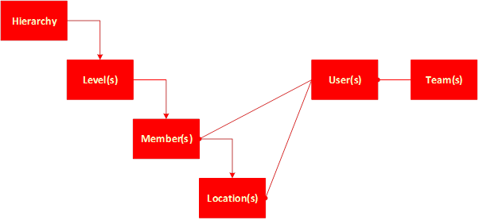
Hierarchy and Alignment
Hierarchies involve an organisational scheme using successive ranks or grades with each a level of users.
Hierarchy: The type of Hierarchy being expressed.
Level: The number of levels defined within the hierarchy. The platform allows for a maximum of 6 levels per hierarchy to be configured.
Locations: Is the lowest level possible in the hierarchy and is derived from the locations supplied in the reference data feed.
Members: is the association of a user to a level in the Hierarchy.
Notes:
Typically, an instance of the platform will have the organizational hierarchy constructed from the location reference data feed. However, additional hierarchy can be configured to describe other organizational configurations which may be internal to LP or other retail business units.

Slide 19
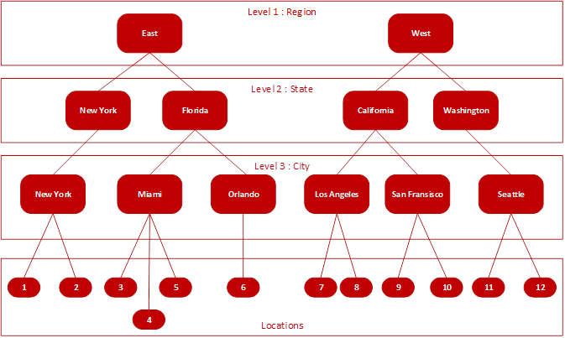
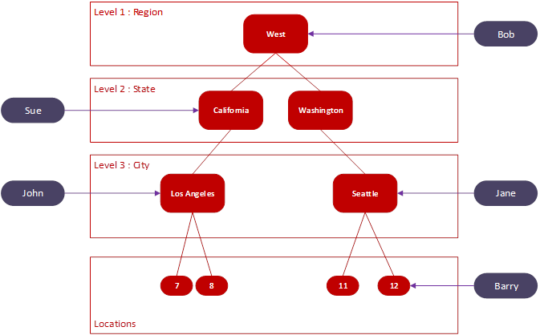
Hierarchy and Alignment Example
Hierarchy
Alignment

Slide 20
Teams
Teams is a simple administrative functions of grouping users into a collection that describes their function within the organization.
Teams should not be confused with User Groups
Use:
Notifications: A notification can be sent to all users in a Team
Data Export: The result of a data export can be sent to all users in a Team
Work Items: A user can restrict a Work Item (WI) to a Team
If a WI is restricted to a Team, a user has to be in the Team to view the WI
If a WI is restricted to a Team and there is also a location tag (Hierarchy 1) – The user needs to be in both in order to see the WI.
Example:
Investigator – Store Ops
Investigator – Financial Controller
Two different Teams for the same Permission Group – they will see different WIs

Slide 21
How do Data Policies work?
Data Policies are created in the Administration module
Data Policies restrict data and they are applied to Permission Groups NOT to Users or Teams
Multiple Data Policies can be applied
Data Policies work over:
Searches
Work Items
Dashboards

Slide 22
Business Calendars

Slide 23
Reporting Requirements

Slide 24
Report Distribution
Hierarchy Restrictions
Teams Restrictions
Report Schedule
Business Calendar
Delivery Time – As soon as it is ready / After a specified time
Day of the Week – As soon as it is ready / After a specified date
Cashier Alert Report
How do AS Watson want to be able to disseminate information to different users?
via Secure?
Manually download reports from Secure and send emails to Store Managers?

Slide 25
LP Case Management
Case Management Dashboard
General Information Form
Case Search

Slide 26
LP Case Management: Case Approver Flow
Secure 5.2

Slide 27



Investigator with an Approver
Case Approved
Case
Closed
Creates Case
Requests Approval
Investigator A
Investigator A
Approver
Case
Rejected

Slide 28


Investigator with an Approver: Reassign Ownership
Case Approved
Case
Closed
Requests Approval
Investigator B
Investigator B
Approver
Case
Rejected
Case Reassigned
Creates Case
Status: Open / Unsaved
Investigator A

Slide 29



Store Case Worker – No Approver
Case Approved
Case
Closed
Reassign
Case
Requests Approval
Store Case Worker
Investigator A
Investigator A
Approver
Case
Rejected
Case Reassigned
Creates
Case
Investigator A

Slide 30
Investigator – No Approver
Case Approved
Case
Closed
Requests Approval
Investigator B
Investigator B Approver
Case
Rejected
Case Reassigned
Creates Case
Status: Open / Unsaved
Approve
Case
Closed
Investigator A

Slide 31
Case Management: Permissions
Secure 5.2

Slide 32
Permissions
Case Dashboard is controlled by Data Policy
An investigator will only be able to see cases based in their regions / areas if Location Hierarchy is setup
An investigator will be able to view cases that are assigned to them and assigned to other users in their region/ area in Case Dashboard
An investigator will be able to open cases that have been assigned to them or where permissions have been granted to the user
Case Search is controlled by Data Policy
General Information Form

Slide 33
Appriss Retail University
User Guide and Component Integration

Slide 34
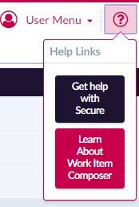
User Guide
User Guide will be available to all Secure Users from within the application
Component Integration
In many areas of the application there are specific training components available by clicking on the question mark icon in the upper left corner.

Slide 35
Secure
Technical Discussion

Slide 36
Technical Discussion
POS Data Feed
Integration Patterns
Reference Feeds
Product Feed
Location Hierarchy Feed
Employee Feed
Other Feed

Slide 37
Thank You

